Slide 1
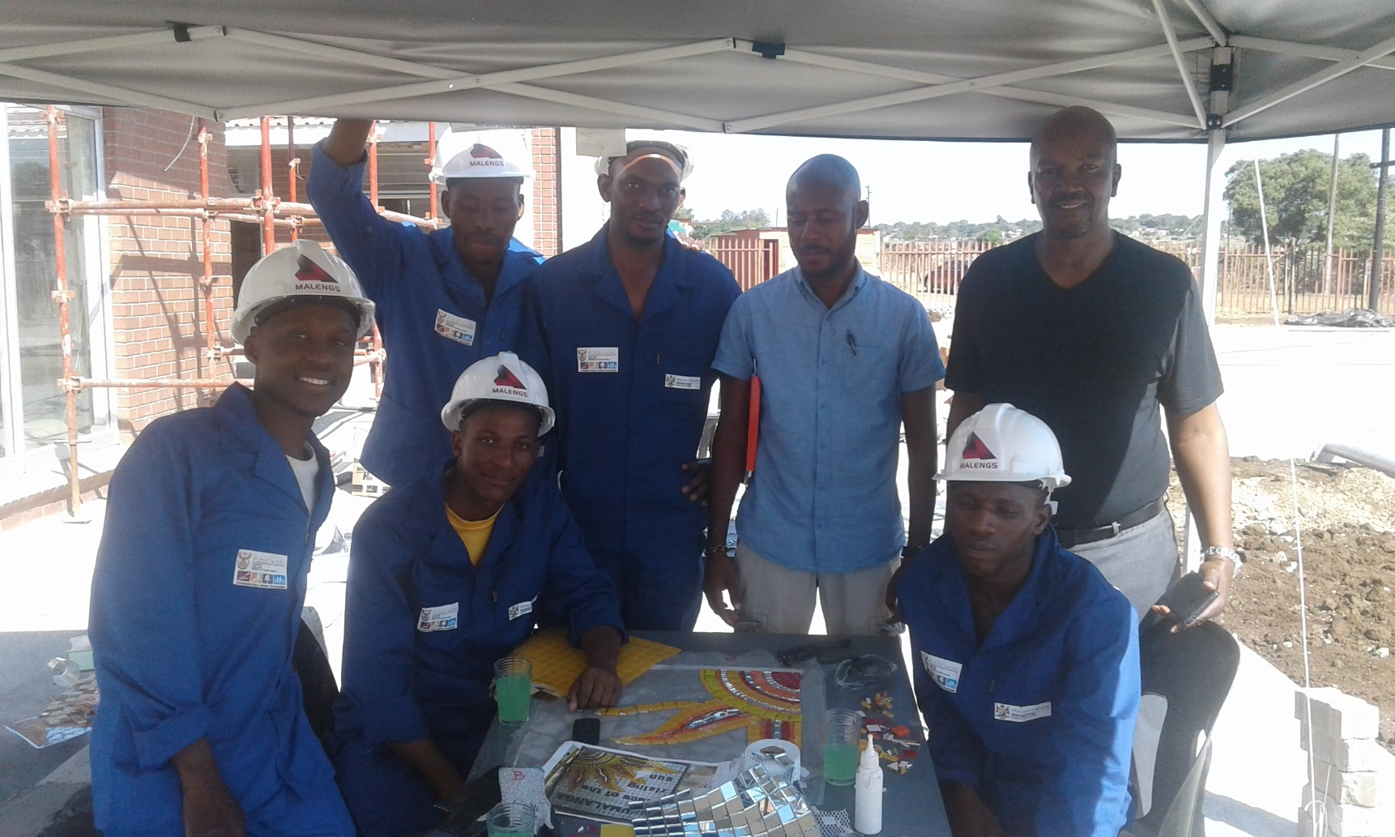
VISION
To help realize Entrepreneurship potential in young black South Africans and provide them with skills and a gateway to the industry and to become the leading black empowerment building and civil engineering contractor in Southern Africa.
ABOUT US
MISSION
VISION
CSI
PROJECTS
DIRECTORS
CONTACTS

Slide 2
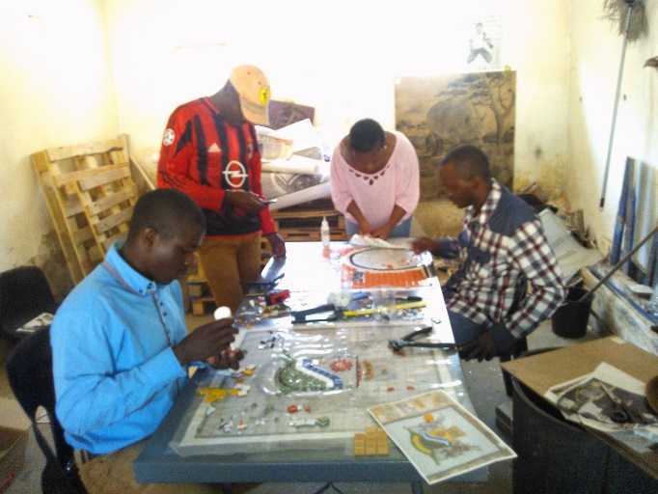
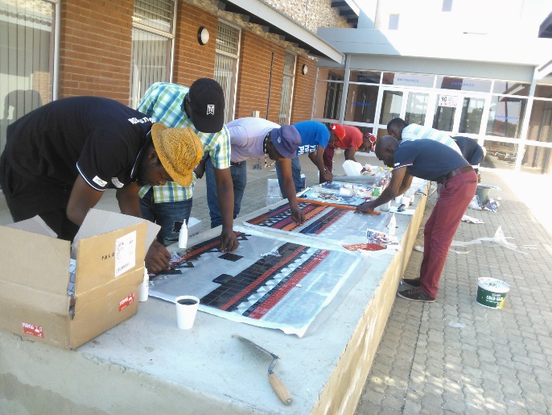
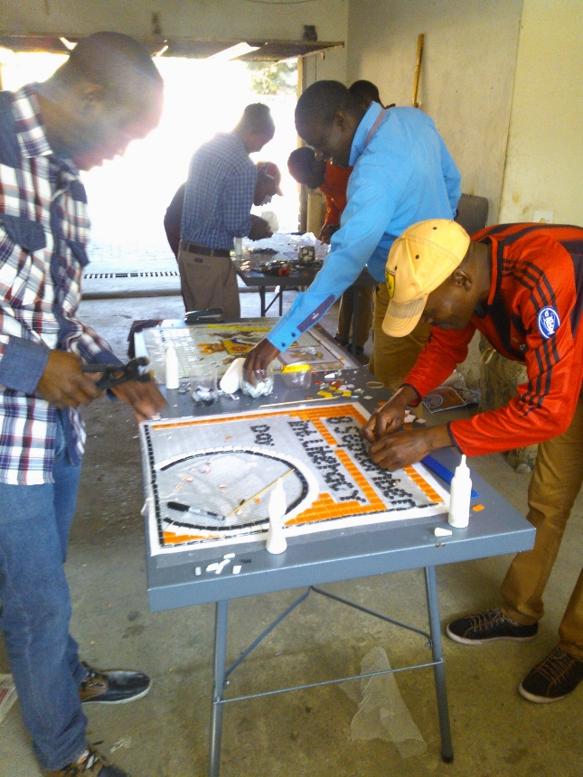
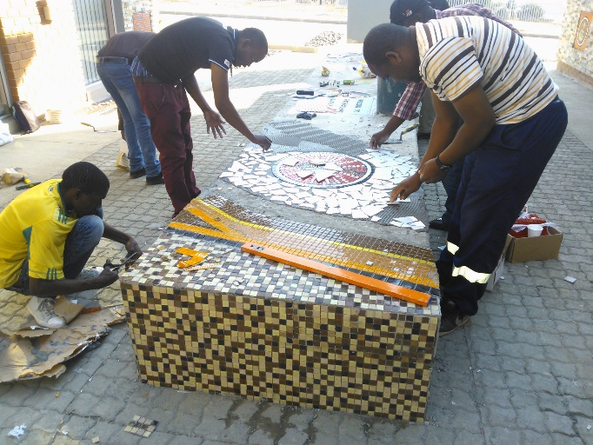
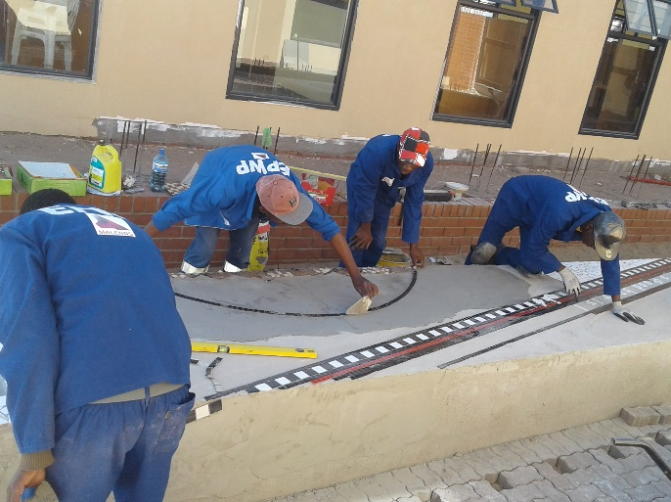
PROJECTS
PROCESS OF PRODUCTION AND INSTALLATION
ABOUT US
MISSION
VISION
CSI
PROJECTS
DIRECTORS
CONTACTS

Slide 3
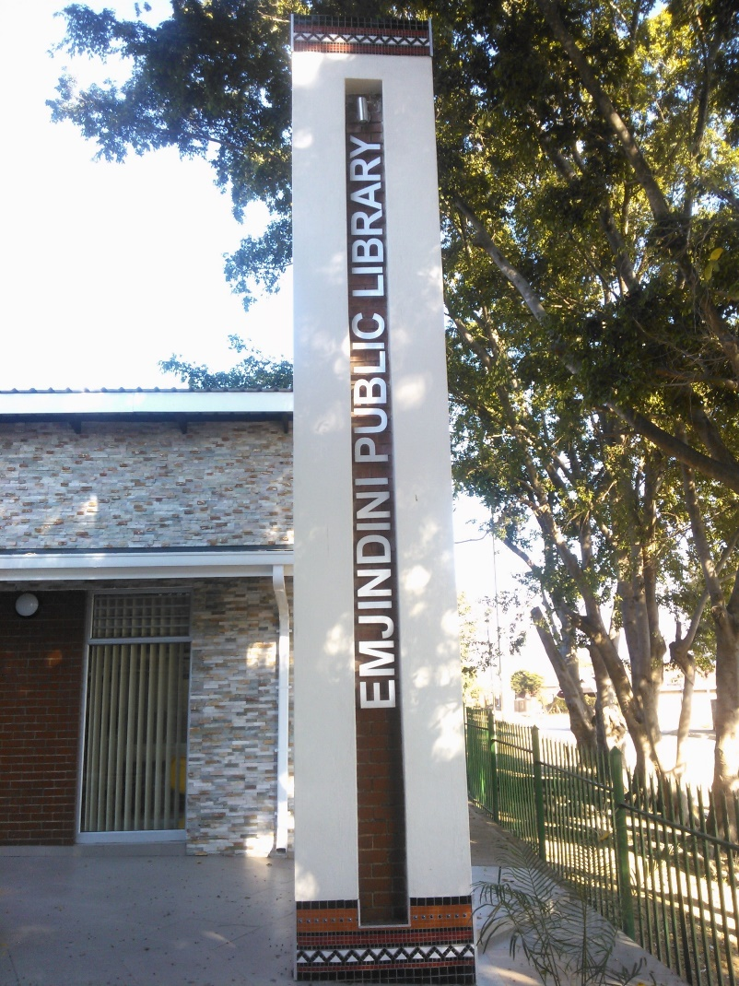
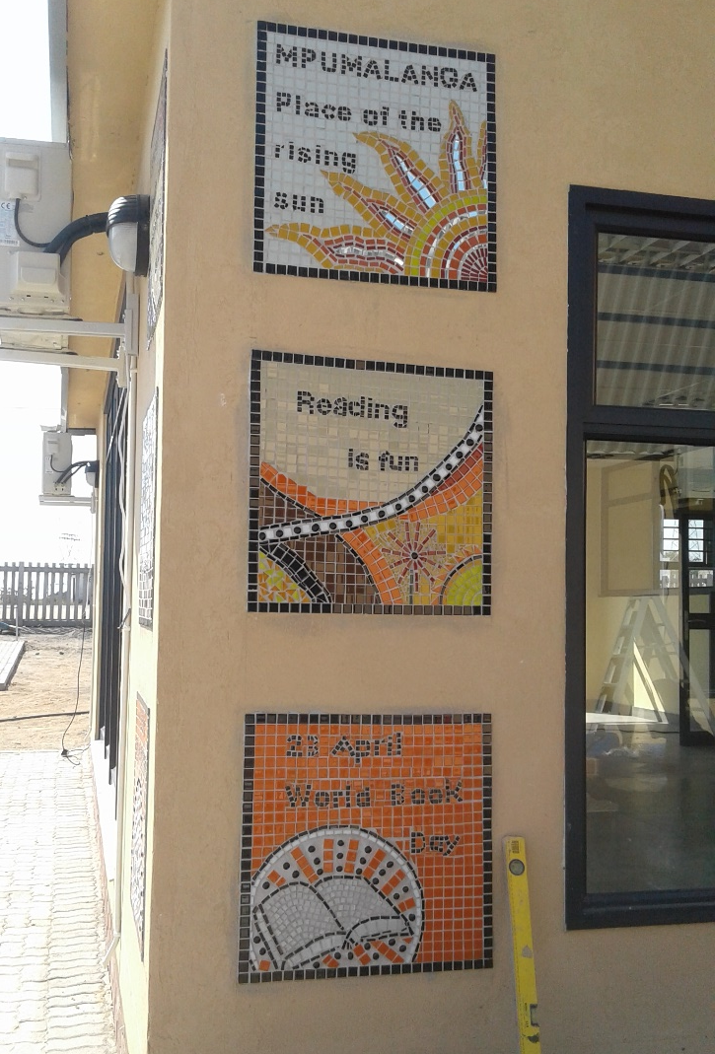
PROJECTS
MOSAIC, TILING AND CLADDING
ABOUT US
MISSION
VISION
CSI
PROJECTS
DIRECTORS
CONTACTS

Slide 4
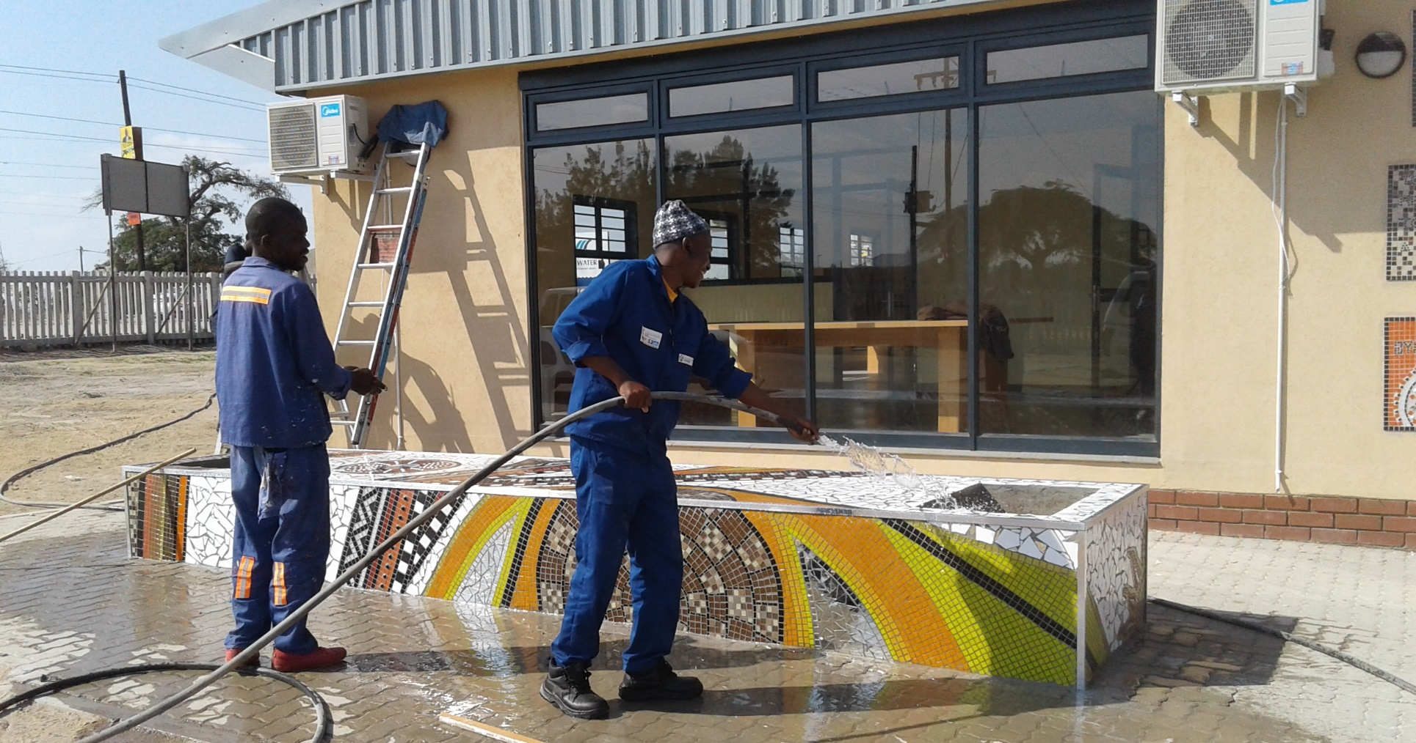
PROJECTS
MOSAIC
ABOUT US
MISSION
VISION
CSI
PROJECTS
DIRECTORS
CONTACTS

Slide 5
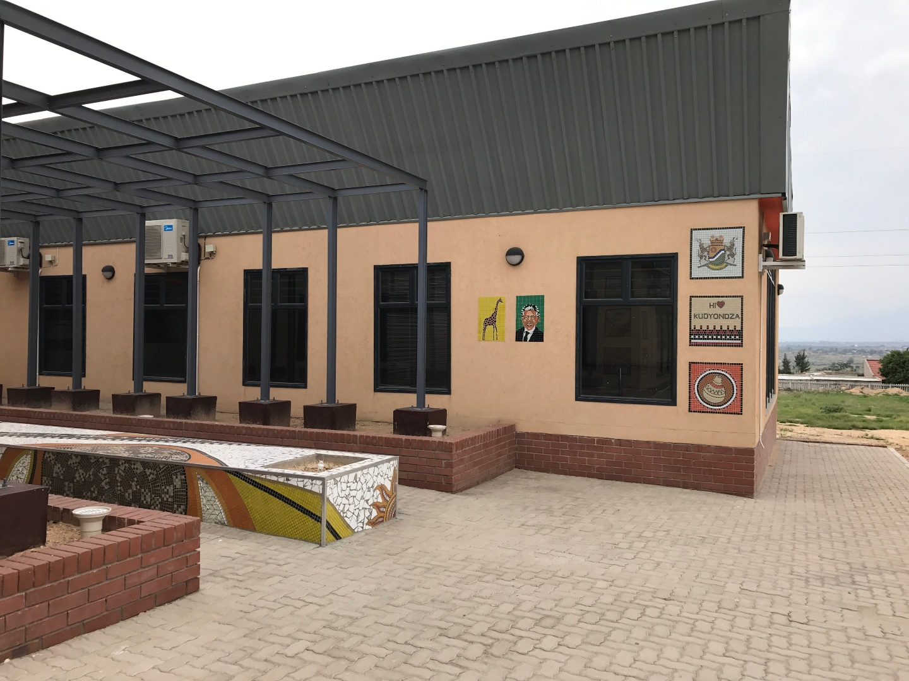
PROJECTS
ABOUT US
MISSION
MOSAIC
VISION
CSI
PROJECTS
DIRECTORS
CONTACTS

Slide 6
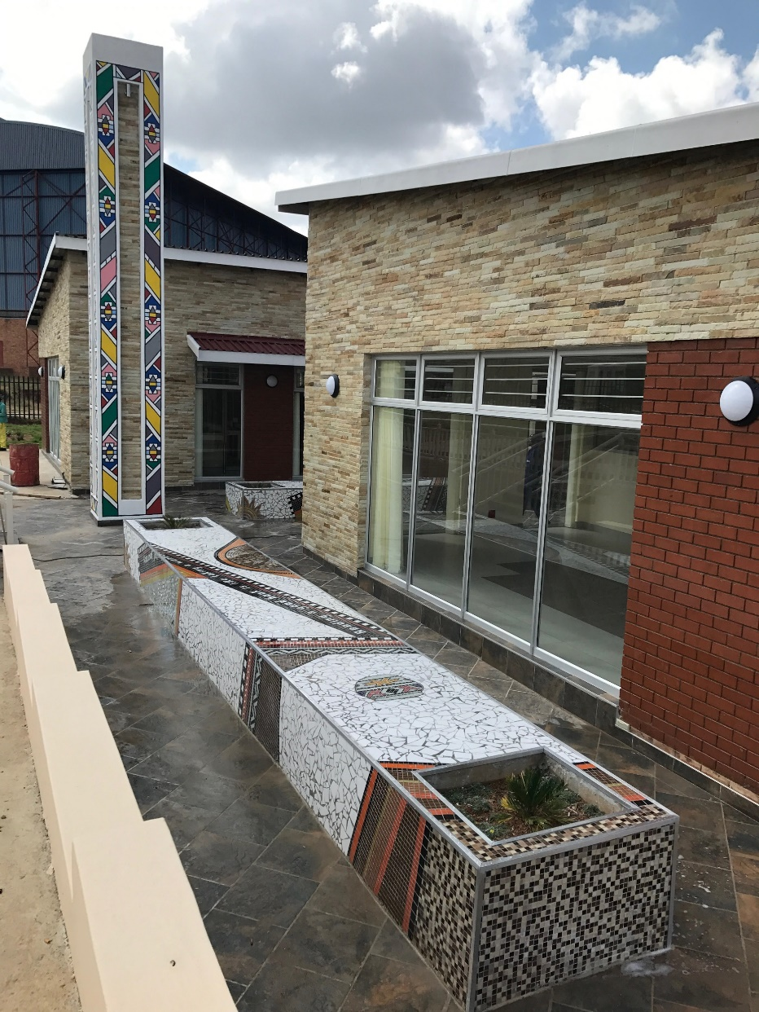
PROJECTS
ABOUT US
MISSION
MOSAIC, TILING AND CLADDING
VISION
CSI
PROJECTS
DIRECTORS
CONTACTS

Slide 7
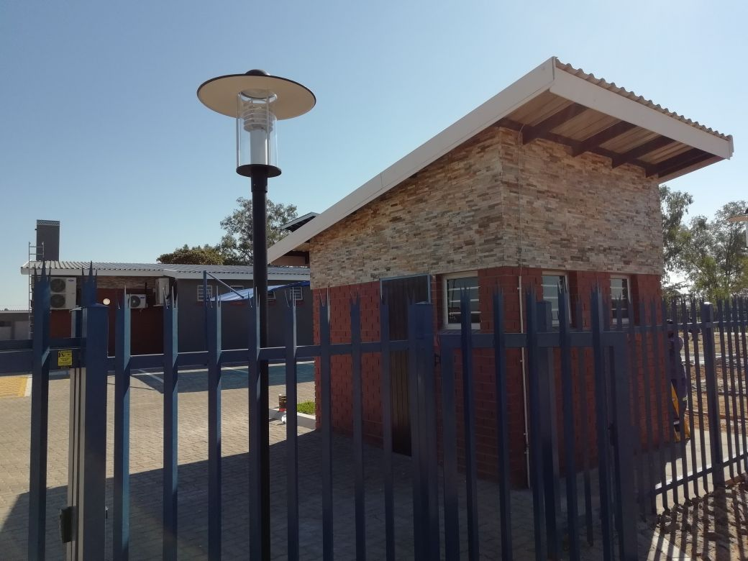
PROJECTS
CLADDING
ABOUT US
MISSION
VISION
CSI
PROJECTS
DIRECTORS
CONTACTS

Slide 8
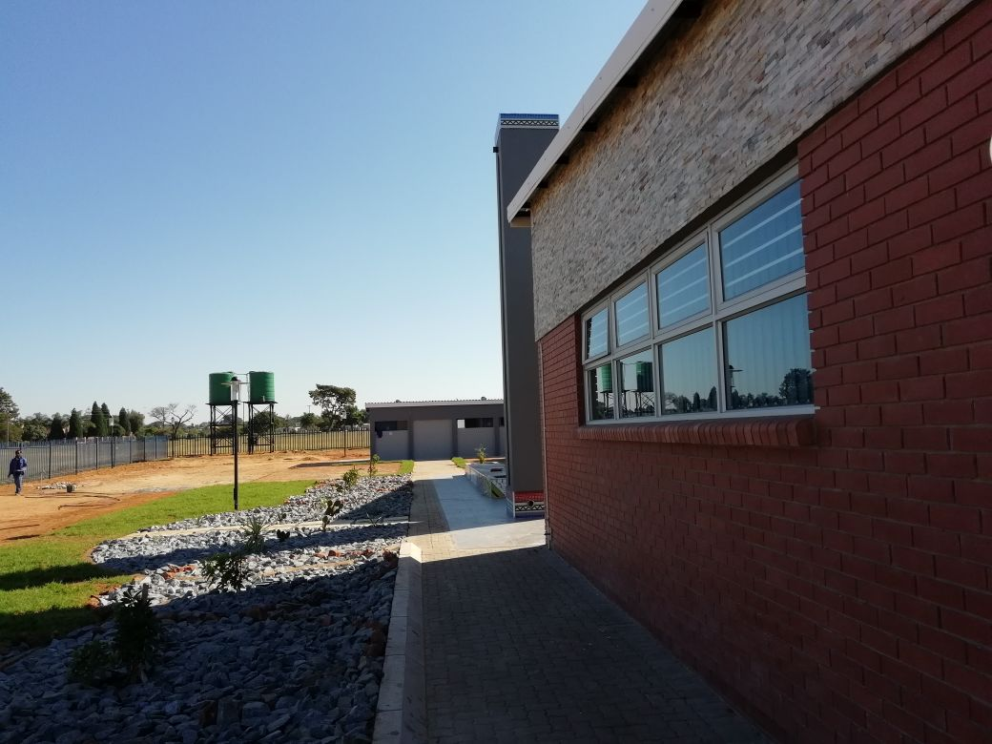
PROJECTS
CLADDING
ABOUT US
MISSION
VISION
CSI
PROJECTS
DIRECTORS
CONTACTS

Slide 9
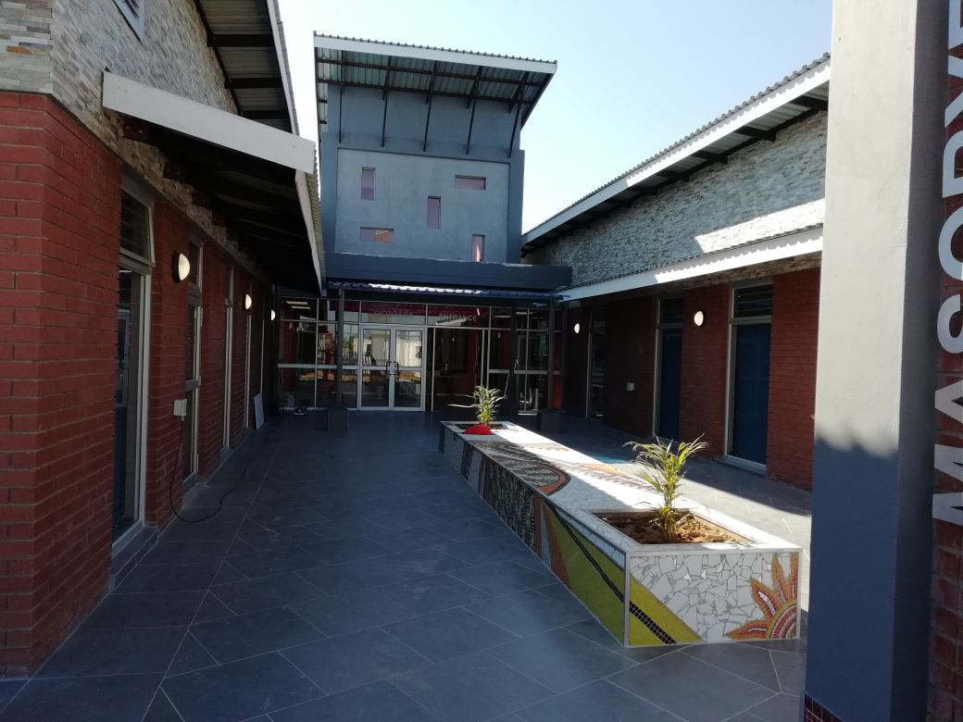
PROJECTS
MOSAIC, TILING AND CLADDING
ABOUT US
MISSION
VISION
CSI
PROJECTS
DIRECTORS
CONTACTS

Slide 10
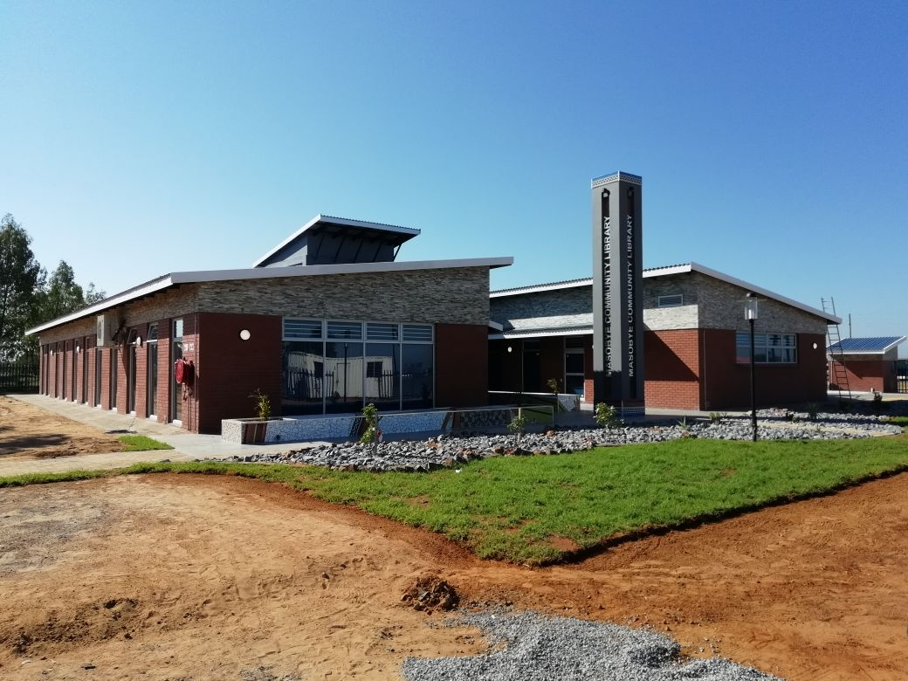
PROJECTS
ABOUT US
MISSION
VISION
CSI
PROJECTS
DIRECTORS
CONTACTS

Slide 11
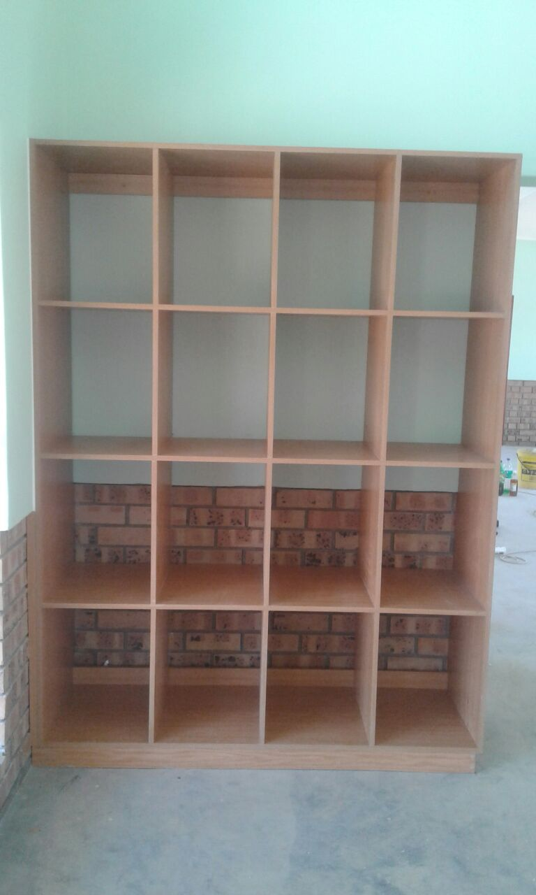
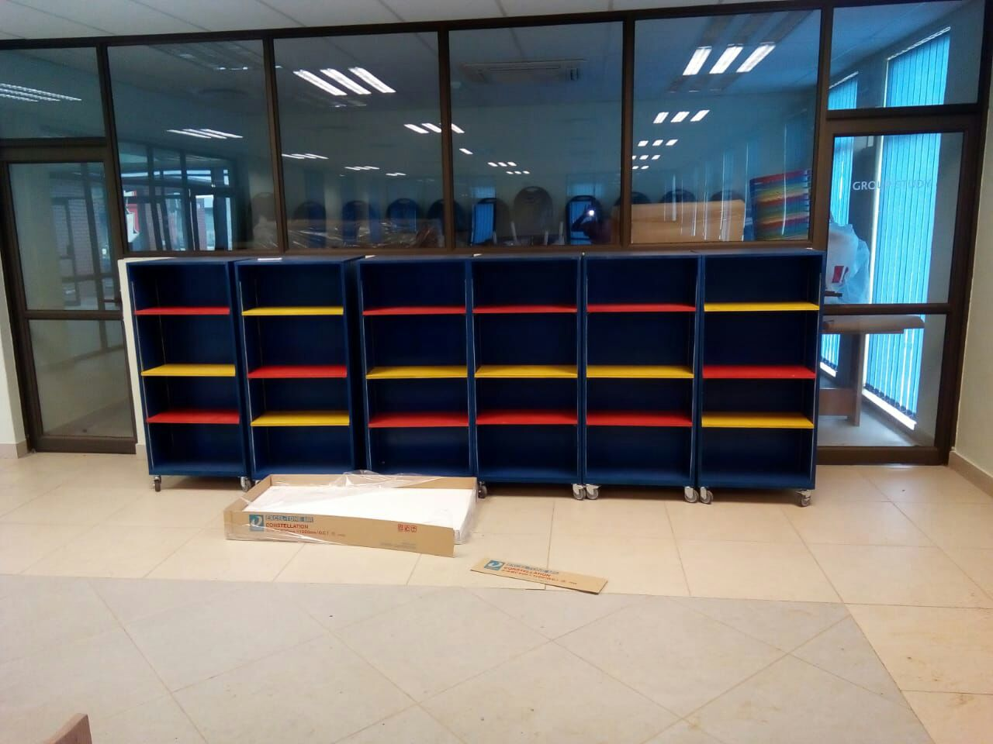
PROJECTS
CARPENTRY
ABOUT US
MISSION
VISION
CSI
PROJECTS
DIRECTORS
CONTACTS

Slide 12
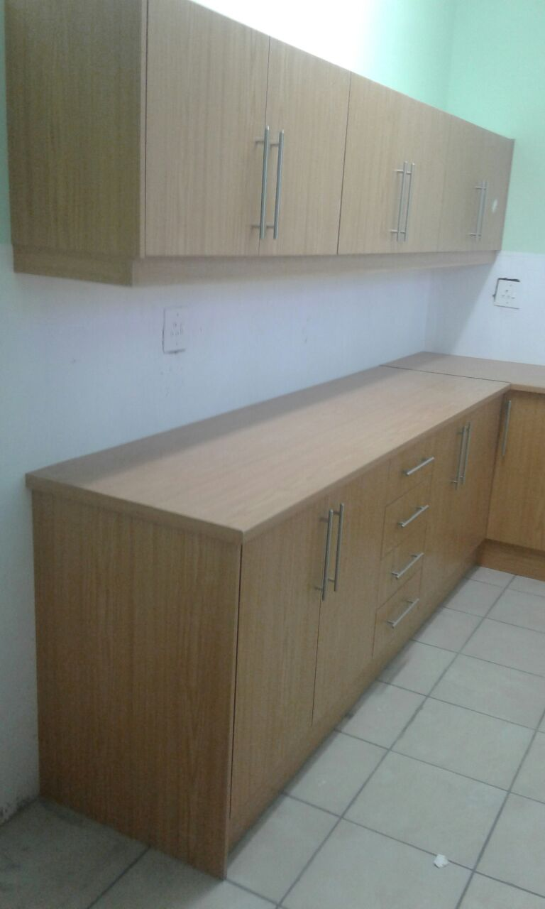
PROJECTS
CARPENTRY
ABOUT US
MISSION
VISION
CSI
PROJECTS
DIRECTORS
CONTACTS

Slide 13
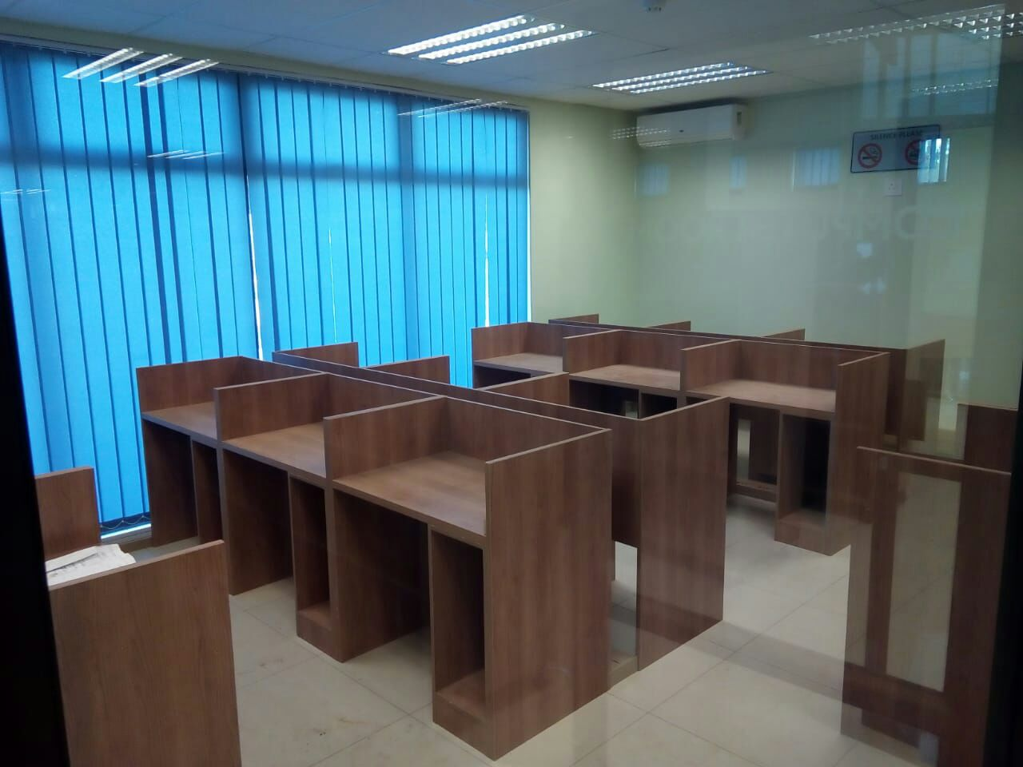
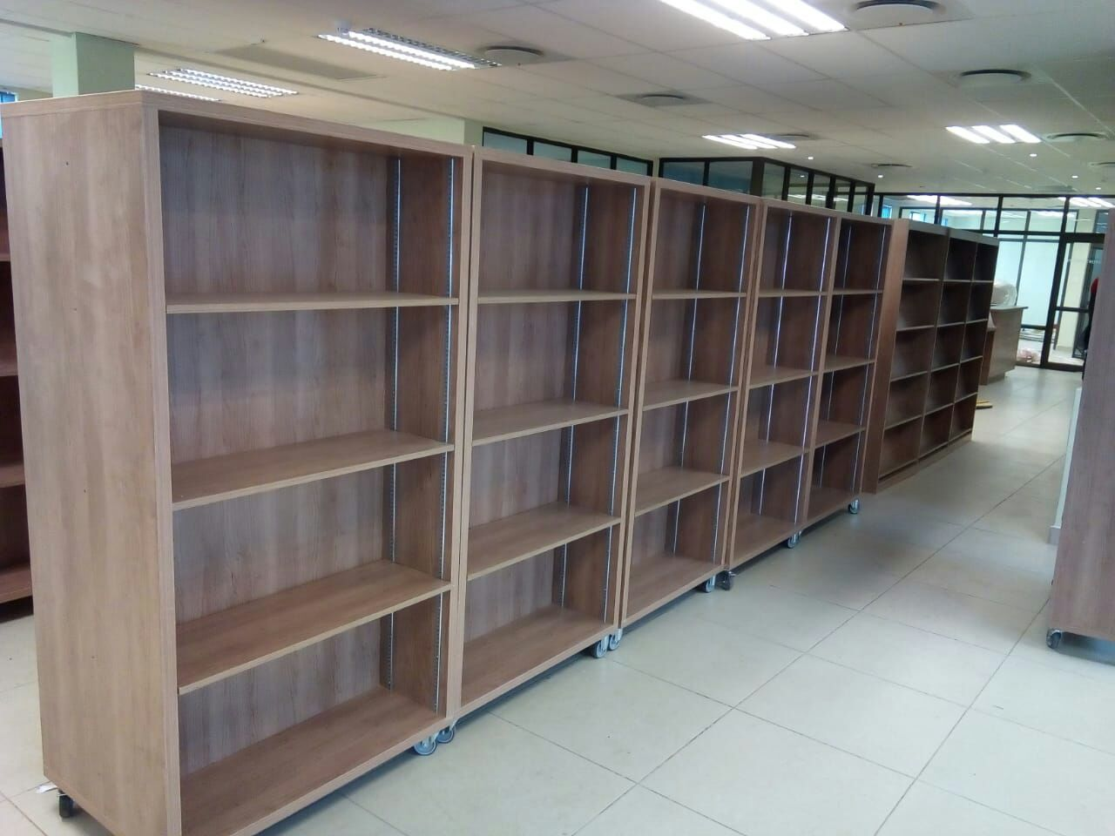
PROJECTS
CARPENTRY
ABOUT US
MISSION
VISION
CSI
PROJECTS
DIRECTORS
CONTACTS

Slide 14
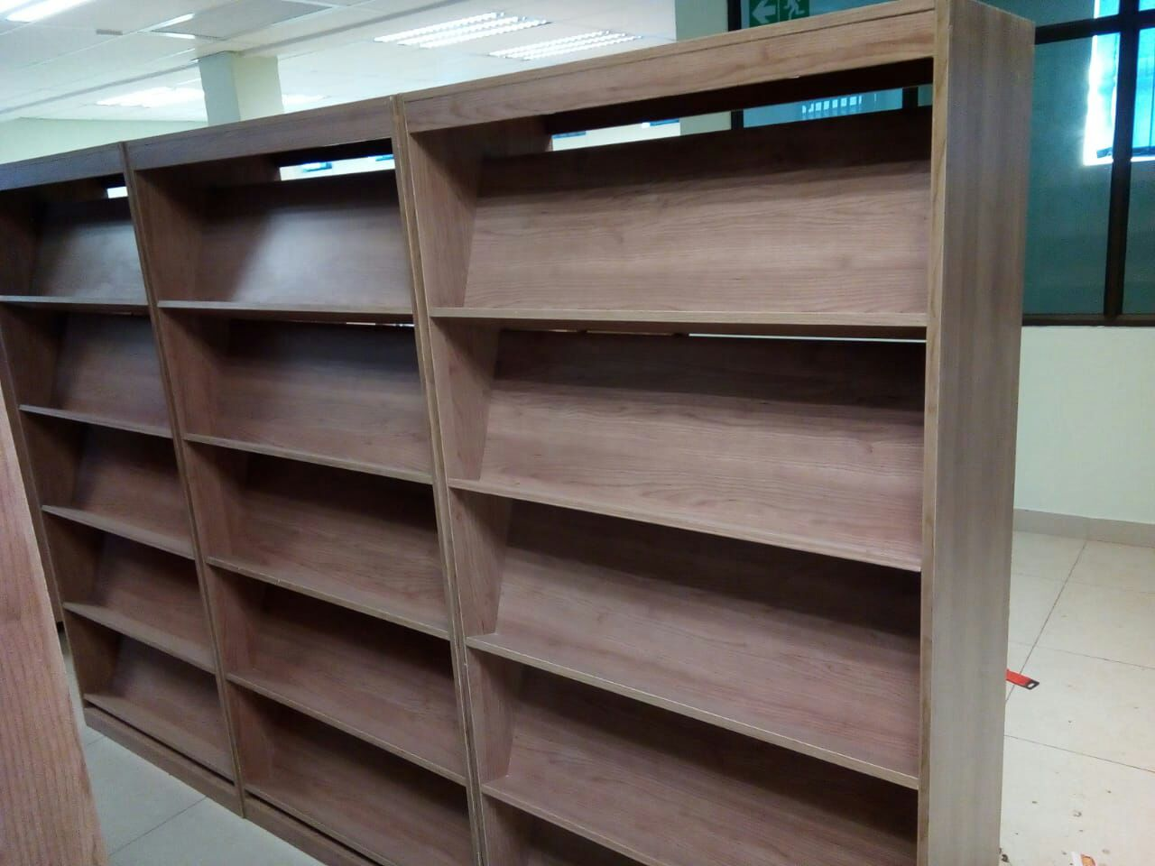
PROJECTS
CARPENTRY
ABOUT US
MISSION
VISION
CSI
PROJECTS
DIRECTORS
CONTACTS

Slide 15
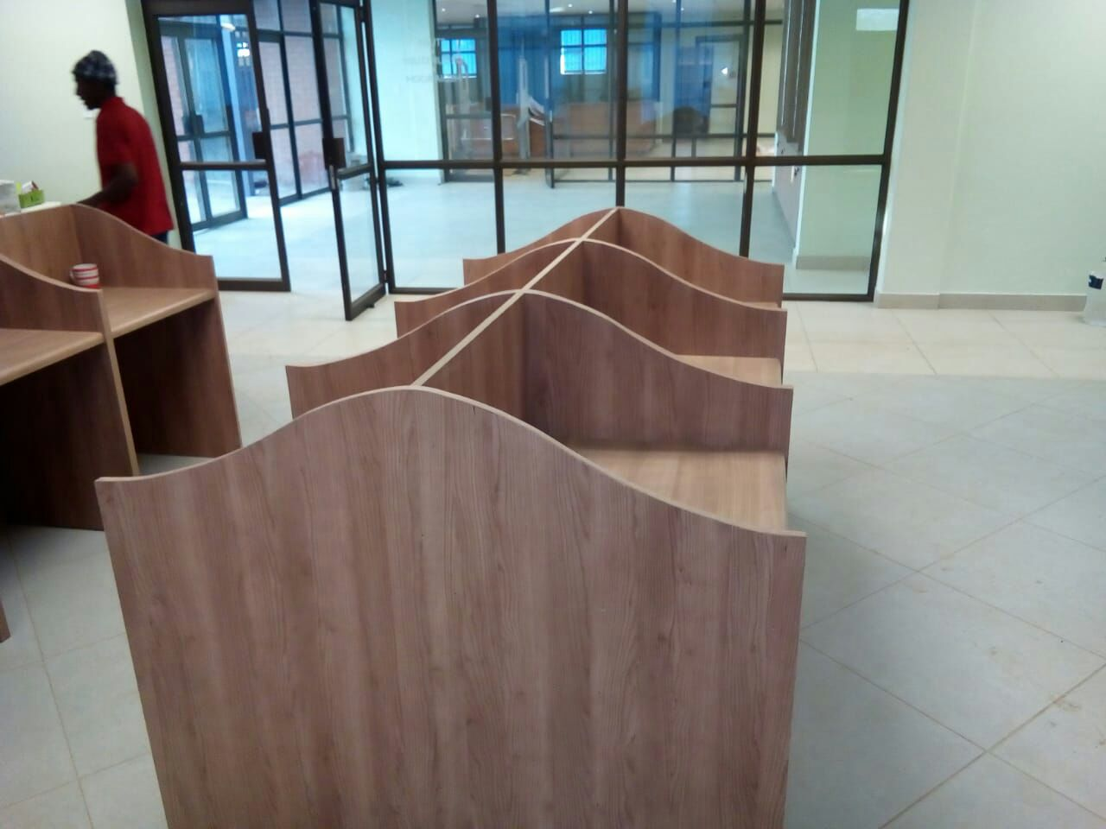
PROJECTS
CARPENTRY
ABOUT US
MISSION
VISION
CSI
PROJECTS
DIRECTORS
CONTACTS

Slide 16
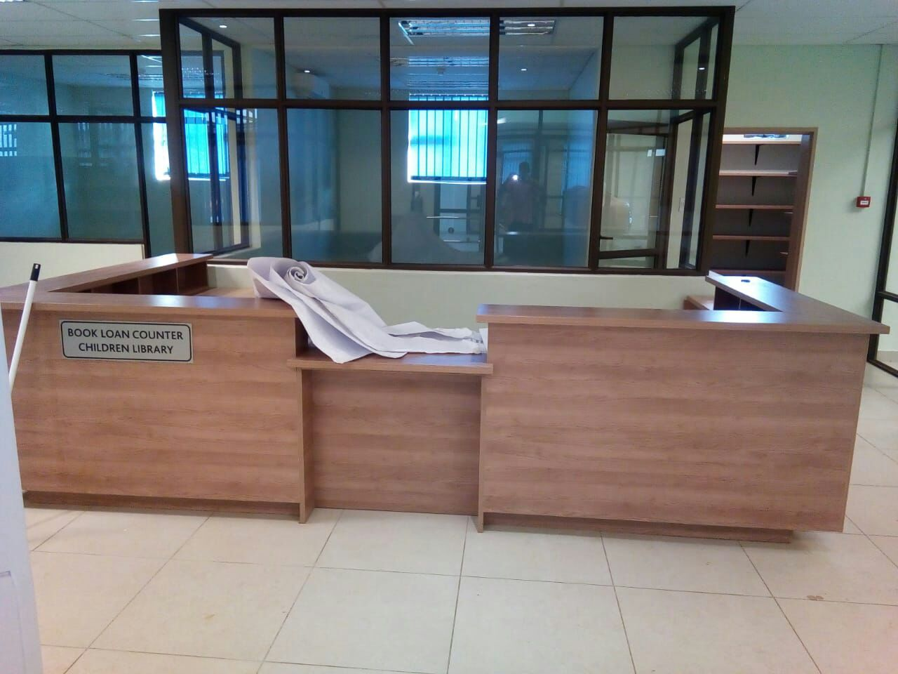
PROJECTS
CARPENTRY
ABOUT US
MISSION
VISION
CSI
PROJECTS
DIRECTORS
CONTACTS

Slide 17
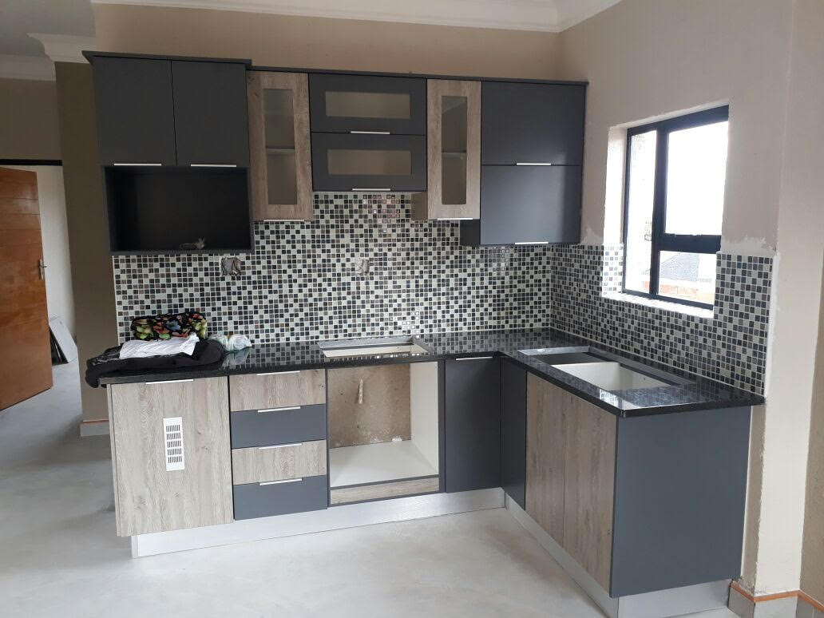
PROJECTS
CARPENTRY
ABOUT US
MISSION
VISION
CSI
PROJECTS
DIRECTORS
CONTACTS

Slide 18
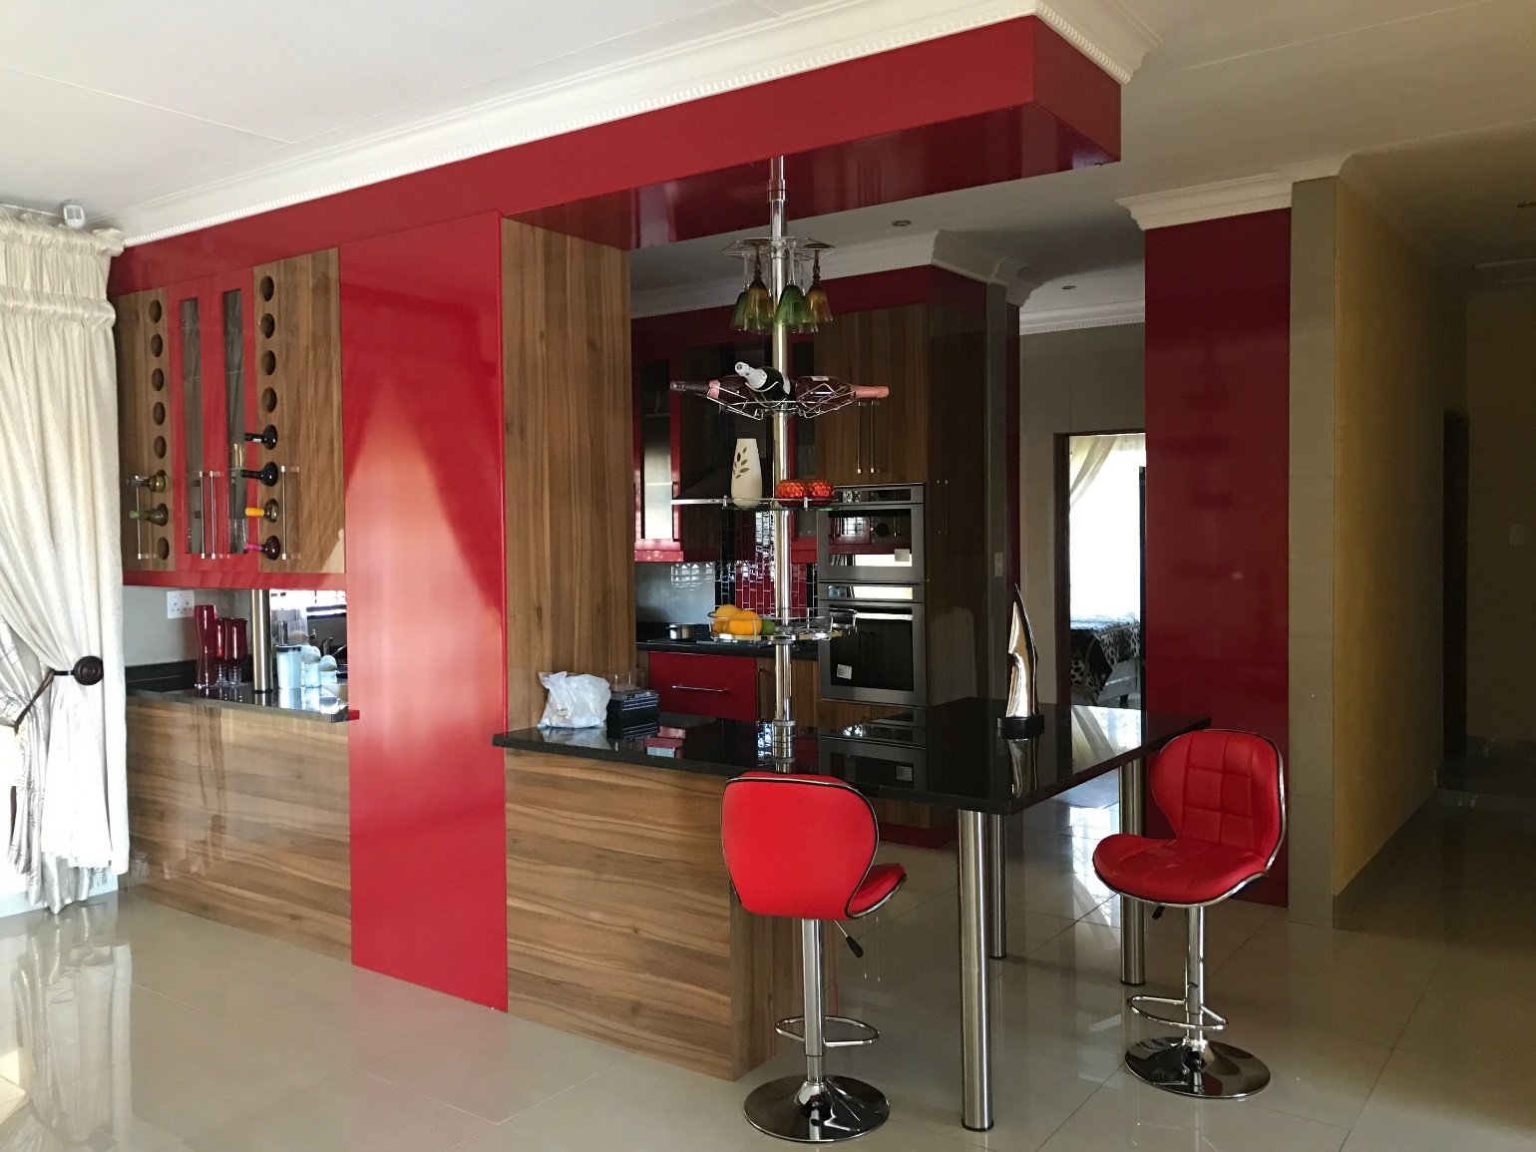
PROJECTS
ABOUT US
MISSION
VISION
CSI
PROJECTS
DIRECTORS
CONTACTS

Slide 19
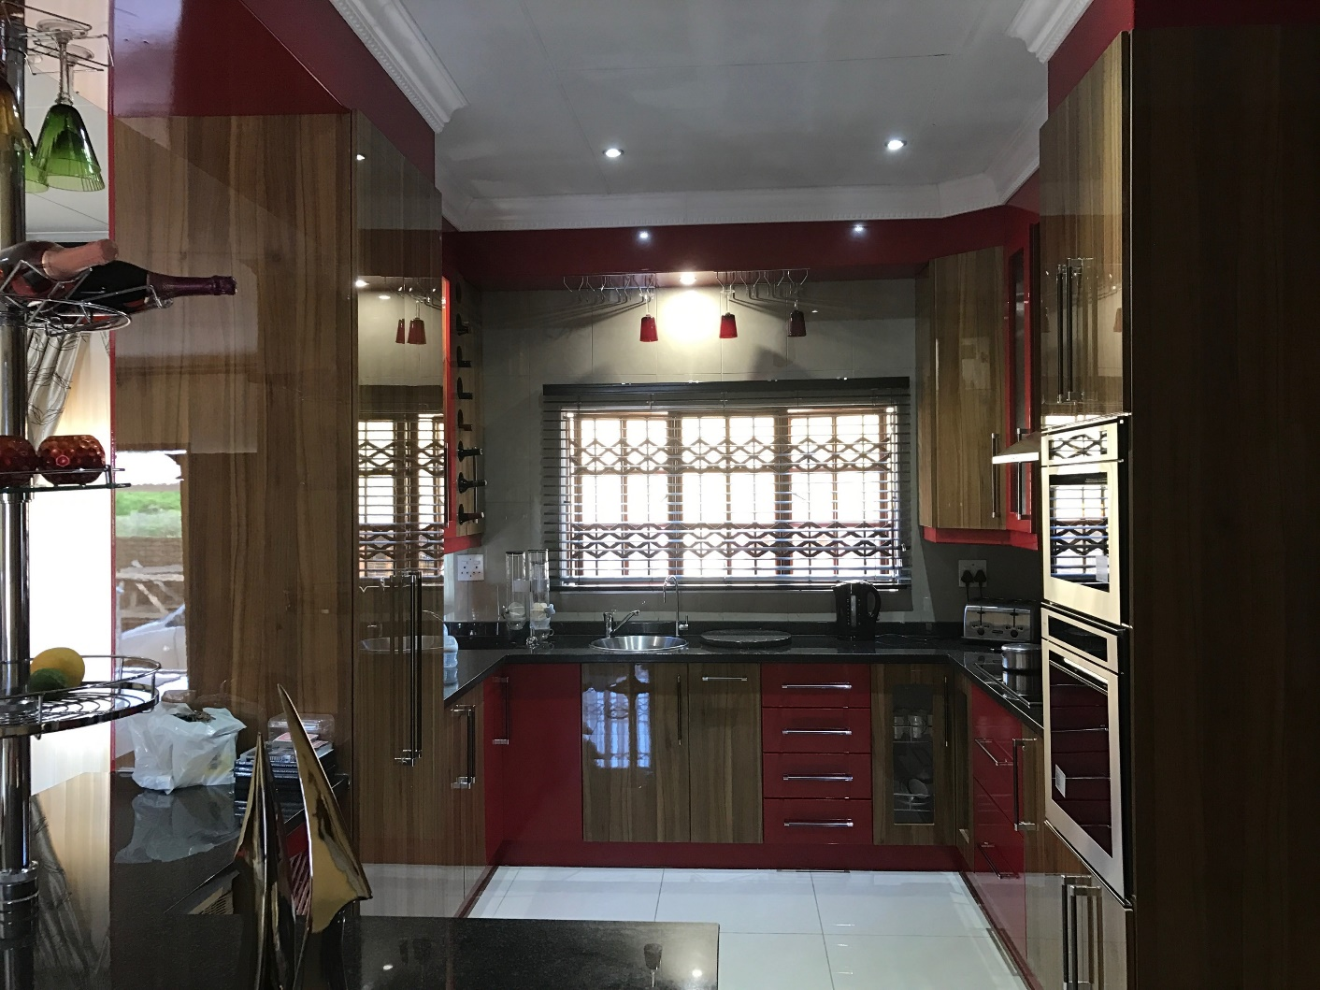
PROJECTS
ABOUT US
MISSION
VISION
CSI
PROJECTS
DIRECTORS
CONTACTS

Slide 20
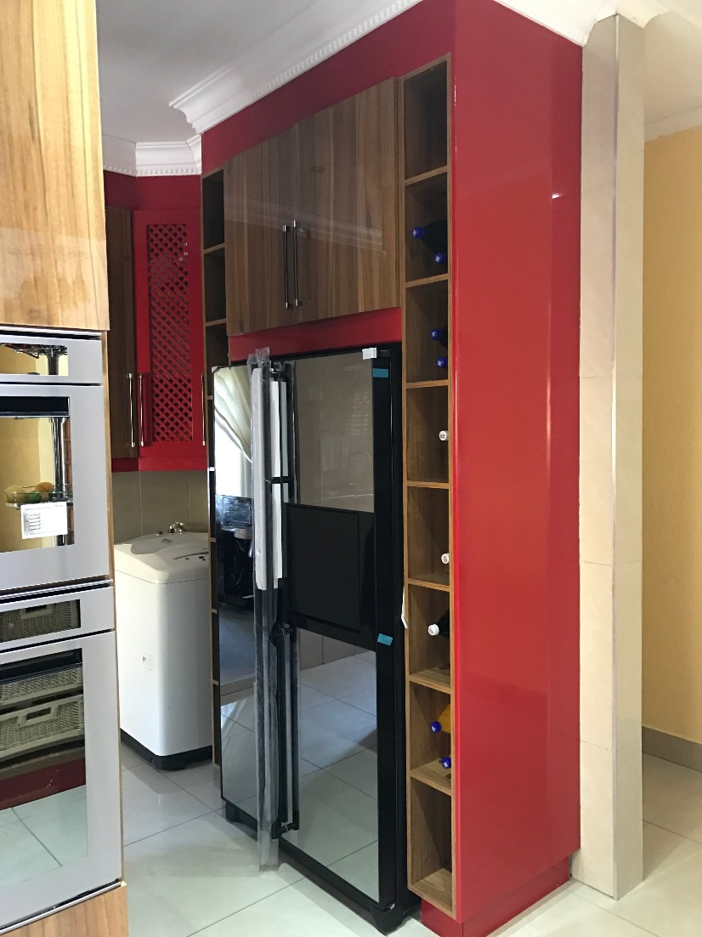
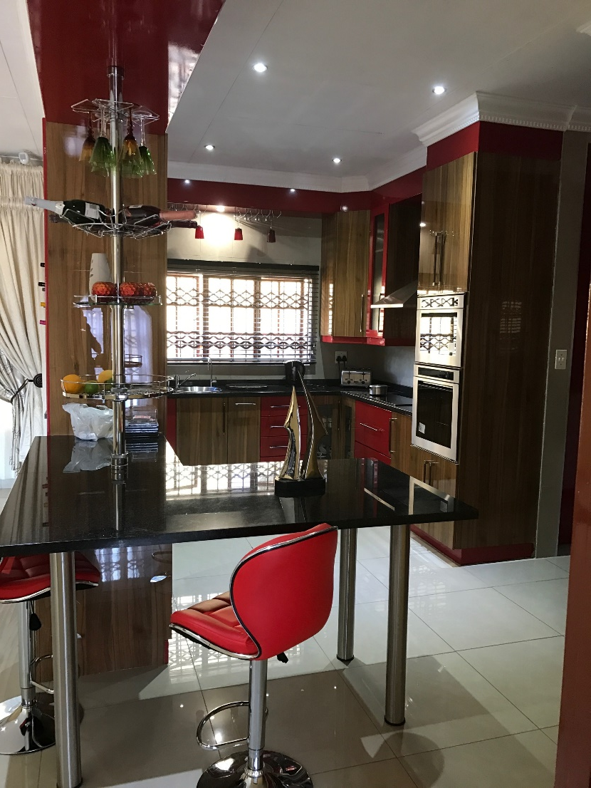
PROJECTS
ABOUT US
MISSION
VISION
CSI
PROJECTS
DIRECTORS
CONTACTS

Slide 21
PROJECTS
ABOUT US
The Mpumalanga Department of Culture, Sport and Recreation requested us to design, produce and install mosaic artwork as a prop for their libraries.
A group of young aspiring artist were chosen from the Expanded Public Works Program (EPWP) to get trained and partake in the production and installation of the mosaic artwork.
The library project for the mosaic artwork were in for the following libraries:
Umjindi Library
Glenmore Library
Machadodorp Library
Mgobodzi Library
Acornhoek Library
Thusiville Library
Verena Library
Boukenhouthoek Library
Balfour Library
Masobe Library
More than 120 artists from different communities were involved in the projects.
MISSION
VISION
CSI
PROJECTS
DIRECTORS
CONTACTS

Slide 22
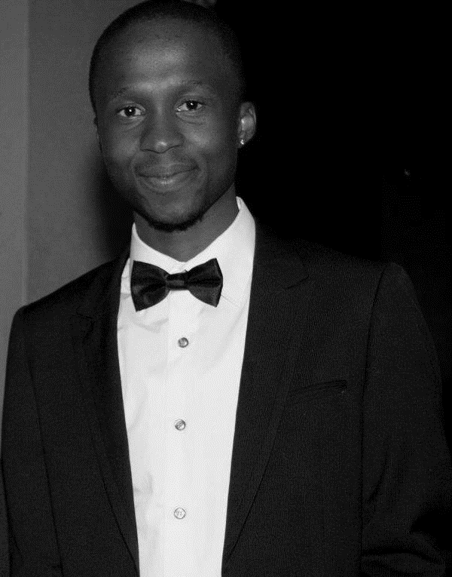
DIRECTORS
ABOUT US
MANDLENKOSI HLOPHE
Founding CEO
Mandlenkosi is a 30 year old award winning entrepreneur who studied Pulp and Paper Technology at UNISA and worked for SAPPI KRAFT NGODWANA as a technician trainee.
With the passion he has for business he started his construction career in 2013. His Management experience started with subcontractors and continued to grow to include, general contracting and being a supplier to the government. His past experience working in all of these venues has provided a broad range of knowledge that affords him the opportunity to provide accurate job cost analysis, and effectively manage the operations, finances and office at Malengs.
MISSION
VISION
CSI
PROJECTS
DIRECTORS
CONTACTS

Slide 23
CONTACTS
ABOUT US
Mandla Hlophe | Director
Email : malengs4u@gmail.com
Cell : 076-235-2679
Fax : 086-274-5843
No. 31 Van Der Merwe
Sonheuwel, Nelspruit
1200
Mpumalanga
South Africa
MISSION
VISION
CSI
PROJECTS
DIRECTORS
CONTACTS

